Slide 1

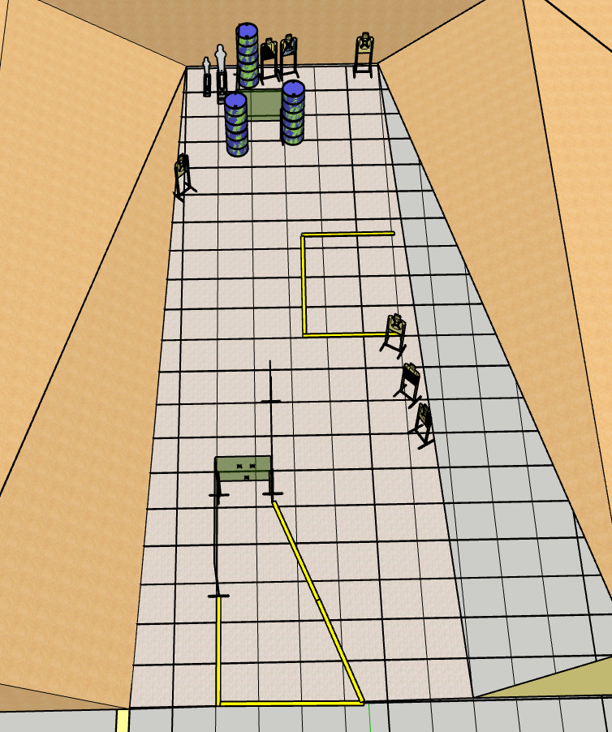
 | Renton Fish and Game Bay 2 They Call Him Hard Cover Mike Course Designer: Eric Beerbaum

Slide 2
Stage 2 They Call Him Hard Cover Mike Course Designer: Eric Beerbaum
They Call Him Hard Cover Mike is a 16 round, 80 point Comstock Long course. There are 7 metric targets and 2 steel targets. The best two hits per cardboard target will score. Steel must fall to score. The start signal is audible.
The Handgun start position is hands touching both of the two upper Xs. Handgun is loaded and holstered. The PCC start position is muzzle touching lower X and stock touching belt. PCC is loaded with safety on.
On the audible start signal, engage all targets as visible from within the shooting area.

